Slide 1
Analyzing Transportation Modes in Geospatial Data Management with Prof. Maria Luisa Damiani
Behnam Najafloo
Master student in Computer Science
University of Milan

Slide 2
Introduction
Importance of location-based services in understanding human mobility.
Overview of the project’s goals: analyzing transportation modes using GPX data.

Slide 3
Project Objectives
Analyze movement patterns recorded in GPX format.
Calculate speed and classify transport modes (walking, bus).
Compare results with manually logged ground truth data.

Slide 4
Methodology
Data Collection
Import GPX File into QGIS
Preprocessing the Data
Calculating Speed
Assigning Transportation Modes
Comparison with Ground Truth

Slide 5
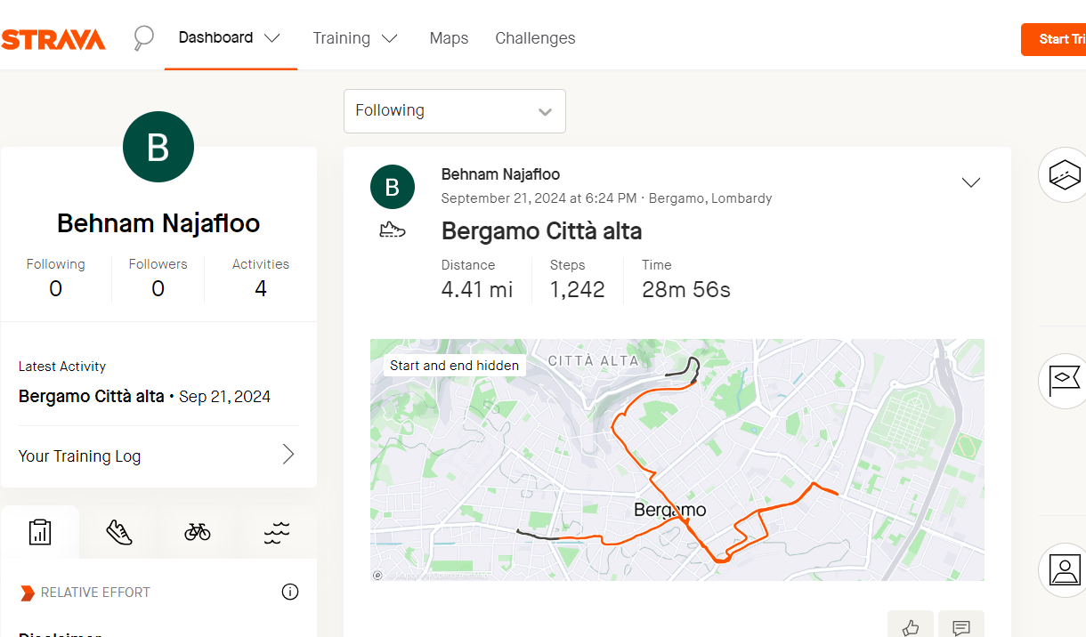
Data Collection

Slide 6
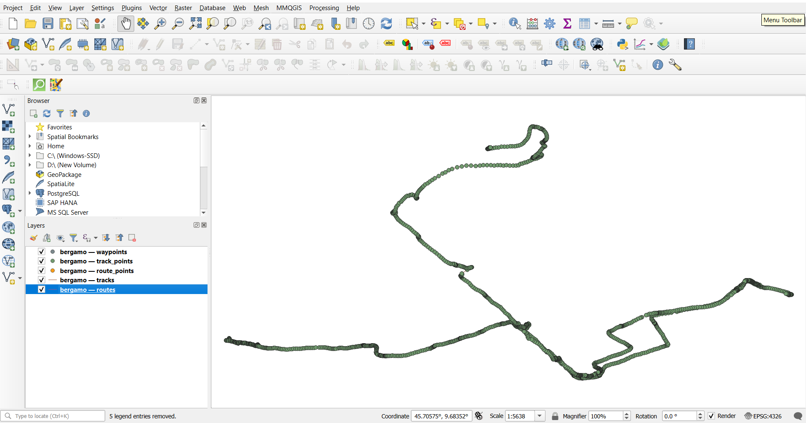
Import GPX File into QGIS

Slide 7
Data Preprocessing
Calculating time differences and distances between points.
SQL queries used for time difference and distance calculations.

Slide 8
Calculating Speed -Formula for speed calculation.
-SQL commands to add speed field and calculate speed in km/h.

Slide 9
Assigning Transportation Modes
if speed == 0:
transport_mode = 'stop'
elif 0 < speed < 5:
transport_mode = 'walking'
else:
transport_mode = 'on the bus'
Define Speed Thresholds: Establish thresholds for different modes of transportation:
• Stop: Speed = 0
• Walking: Speed between 0 and 5 km/h
• On the Bus: Speed greater than 5 km/h

Slide 10
Comparison with Ground Truth
Importance of ground truth for validation.
External information:
You could also rely on external data, like a schedule for the bus route or any timing information for specific segments.
Manually record activities:
While collecting the GPX data, you can keep a log or note down what you were doing at specific times (e.g., noting when you were walking, on the bus, or stopped).

Slide 11
Results and Findings
Results:
• The speed ranged from around 3 km/h (walking) to over 10 km/h (bus rides), aligning
with expected values.
• The transport modes accurately reflected the transitions between walking and
riding a bus when compared to the ground truth, although there was a time zone
discrepancy that had to be accounted for.
Expected Outcome:
• At 16:25-16:40: I should see that my transport_mode is set to "on the bus" and speeds are relatively high.
• At 17:06-17:11: The same applies for bus number 7.
• At 17:11-17:14: I should observe walking mode with a speed of approximately 3-5 km/h.
• At 17:14-17:29: Again, expect a return to "on the bus" with a higher speed.

Slide 12
Visualization and Analysis
Techniques for visualizing data in QGIS
Symbology
Labeling

Slide 13
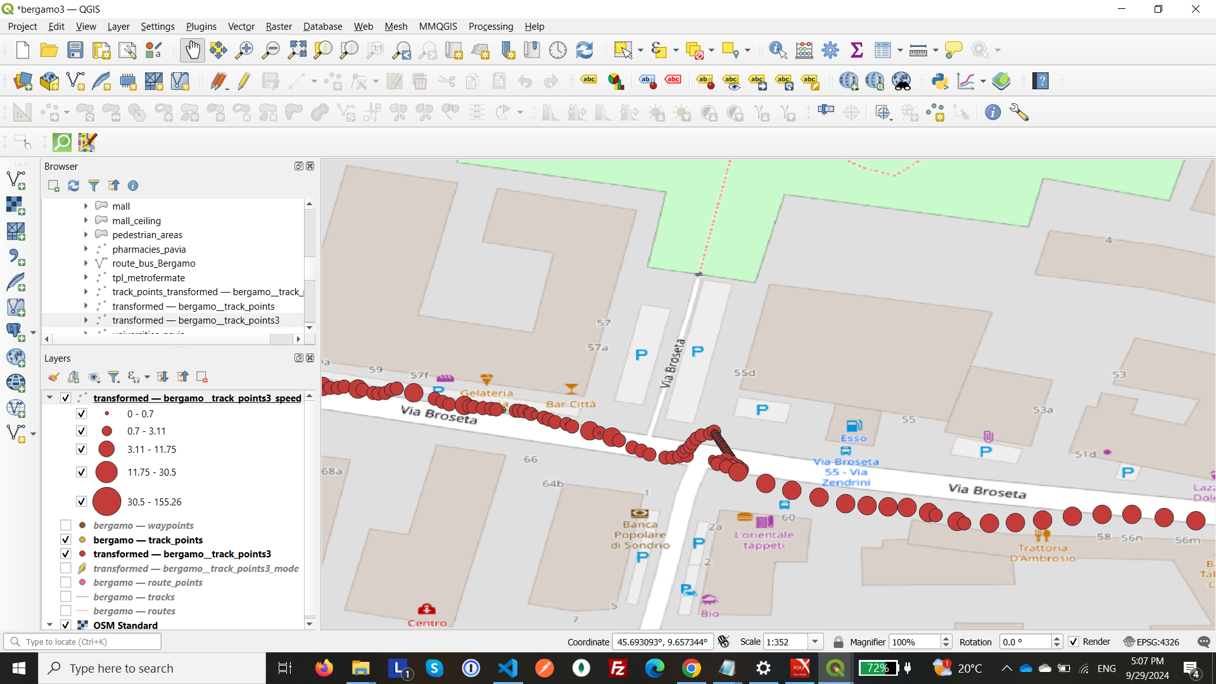
Add Symbology

Slide 14
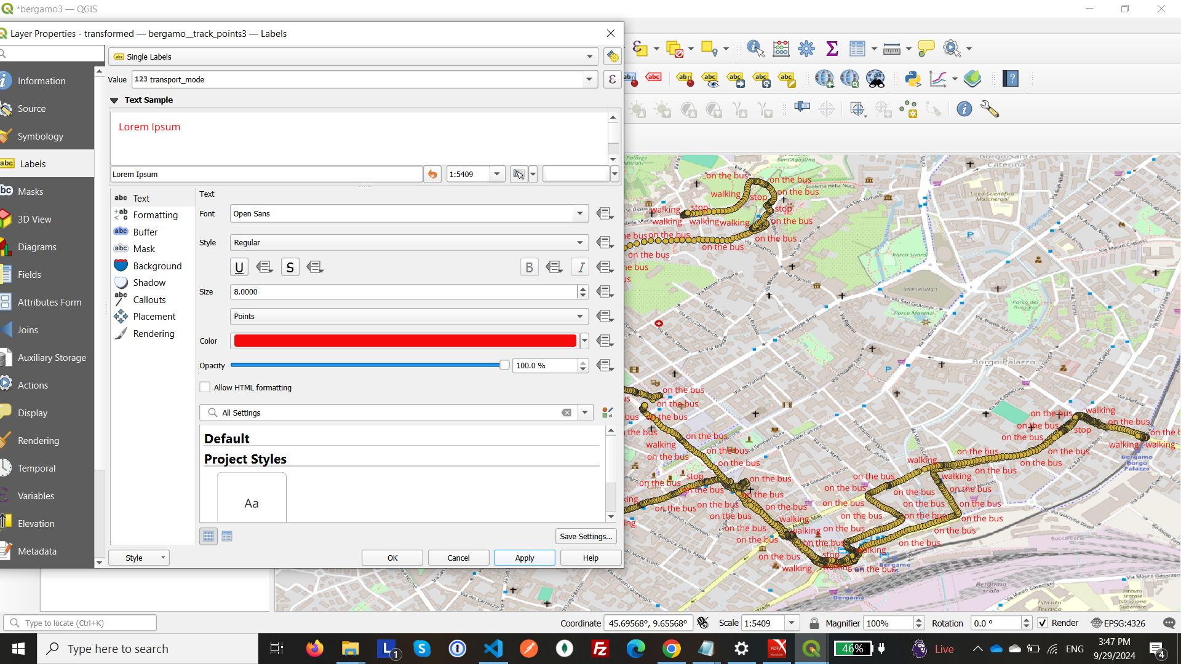
Style by Labels

Slide 15
Challenges and Solutions
Time Zone Mismatch.
Noise in Data.
Zero or Negative Time Differences.

Slide 16
Conclusion
The project demonstrated accurate analysis and classification of transportation modes using trajectory data with QGIS and Python.
Comparison with manual ground truth logs confirmed the analysis's reliability.

Slide 17
References:
• QGIS Documentation
• Python API for QGIS
• GPX File Data Sources (Geo Tracker, Strava)

Slide 18
End

